Slide 1
Microsoft Power BI

Slide 2
Advanced Dataset Programming with Power BI
Ted Pattison
Principal Program Manager
Power BI Customer Advisory Team (PBICAT)

Slide 3
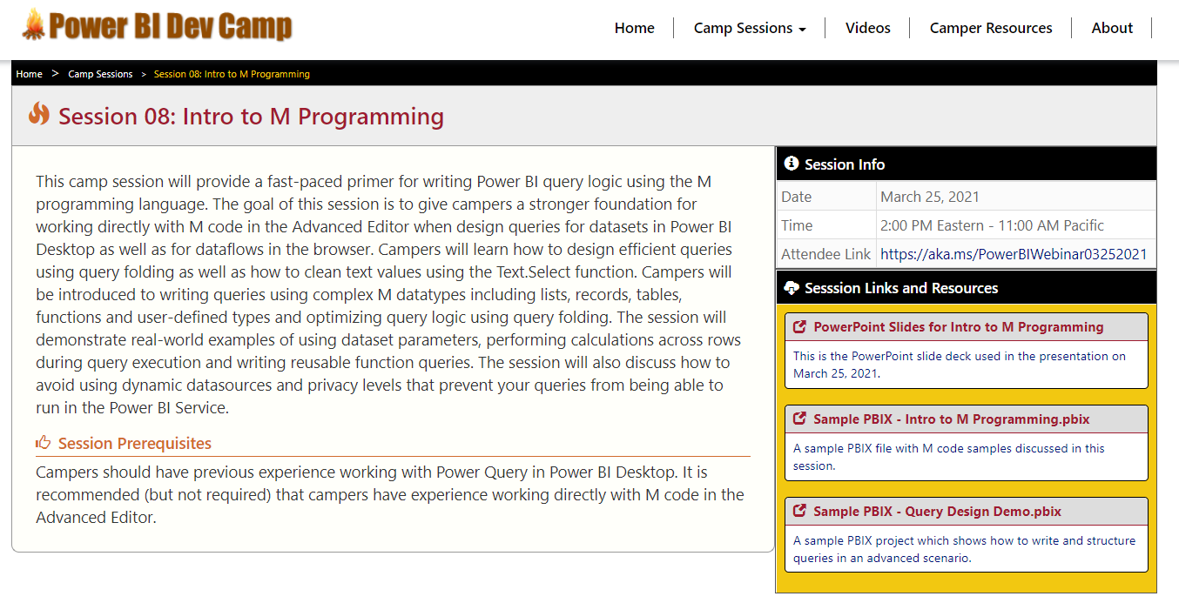
Welcome to Power BI Dev Camp
Power BI Dev Camp Portal - https://powerbidevcamp.net

Slide 4
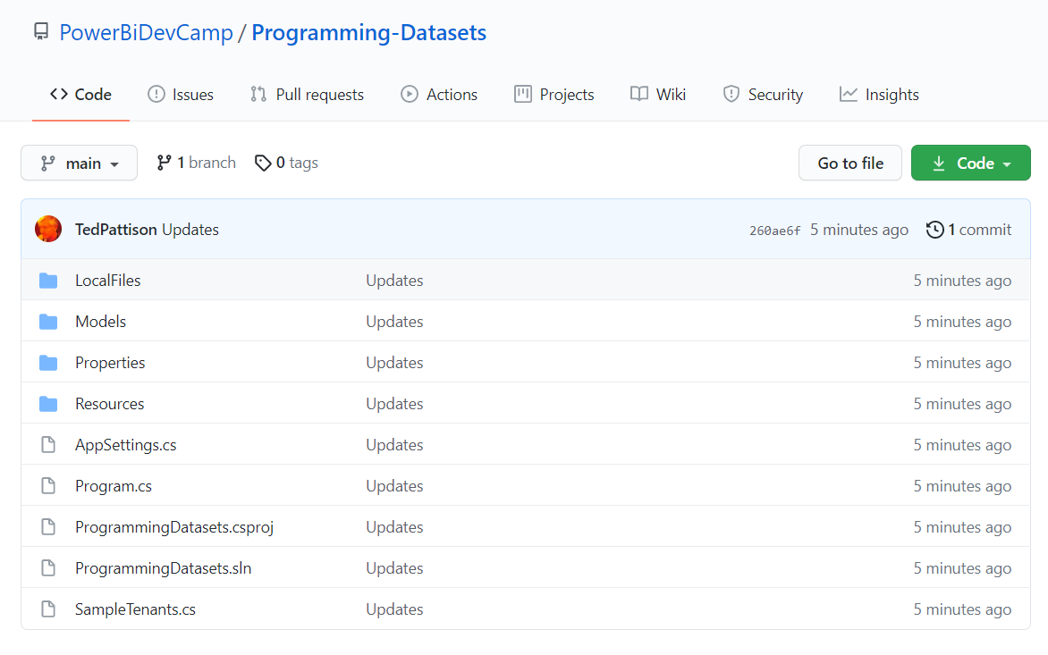
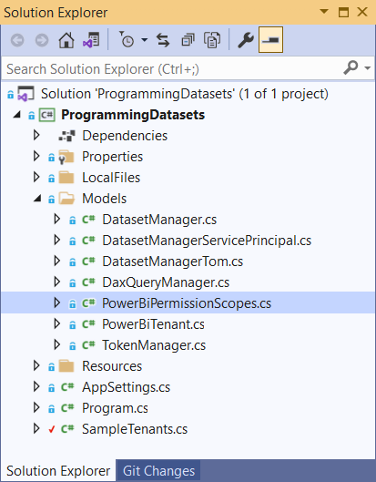
Sample code for this session in C# console app
https://github.com/PowerBiDevCamp/Programming-Datasets

Slide 5
Agenda
Power BI Dataset Programming Overview
Programming Datasets with the PBI REST API
Programming Datasets as Service Principal
Programming Datasets using Tabular Object Model
Scaling with App-Owns-Data in Multi-tenant Scenarios

